Slide 1
Comparing two products
Basic 12 Unit 11b

Slide 2
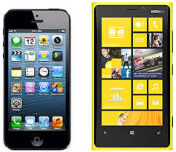
Think of 2 products you can compare

Slide 3
Brainstorm :
 | Iphone | Nokia lumia
Camera | Good pictures | Good pictures
Apps | There are many | There aren´t many
Operational system | IOS 8 Quick It doesn´t crash often | Windows Phone Slow It crashes often
Price | Expensive | Affordable
Design | nice | nice

Slide 4
Cell Phone Use
There are many kinds of cell phones at stores, but there are two that I like more.
I used to have a Nokia Lumia, but a few days ago i changed to an iPhone and I can say that there are similarities and differences between the phones.

